Slide 1
Week 1: Introduction and Fast Basics of C#
.NET Development Workshop Series

Slide 2
What is the .NET Framework?
A managed execution environment that provides a variety of services to its running applications
Consists of 2 major components
Common language runtime (CLR), which allows different .NET languages to interact with each other
Base Class Library, in this case the .NET Framework Class library (can also be .NET Standard Class library)
Provides a library of tested, reusable code that developers can call from their own applications

Slide 3
More on base class library
.NET Framework was originally developed for windows
.NET Framework class library can only be used for windows
Recently a more portable version was made, using stripped down version of .NET Framework
.NET Standard
.NET Standard class library can be used in all major platforms, Windows, Linux, Mac, Android, iOS
This is the one used when developing mobile apps using Xamarin

Slide 4
More on CLR
The common language runtime (CLR) allows many languages to work interchangeably together with each other
As long as it is supported on the .NET Framework
Has a common type system (CTS)
Achieved by compiling different languages into a similar intermediate, before finally being converted to machine code

Slide 5
Our Focus
Basically, the .NET Framework can be treated as an environment that allows us to use their libraries and build applications
Because of the CLR, there are many programming languages we can use, but we’re focusing on building traditional Win32 applications using C#

Slide 6
.NET Languages and Frameworks
Languages
C++/CLI (a variant of C++)
C#
Frameworks
Win32
Universal Windows Platform (UWP)
JavaScript
F#
Visual Basic .NET
Windows PowerShell
A hell lot more you never heard of
ASP.NET
Xamarin/Mono
Silverlight

Slide 7
Quick Survey
How much do you know about coding/programming?
1. Super new, what’s that BTW?
2. My course made me learn that… So yeah
3. Somewhat comfortable with it.
4. I’m not here to learn. I’m here to challenge.

Slide 8
C# Quick Start Guide
A short and fast one.

Slide 9
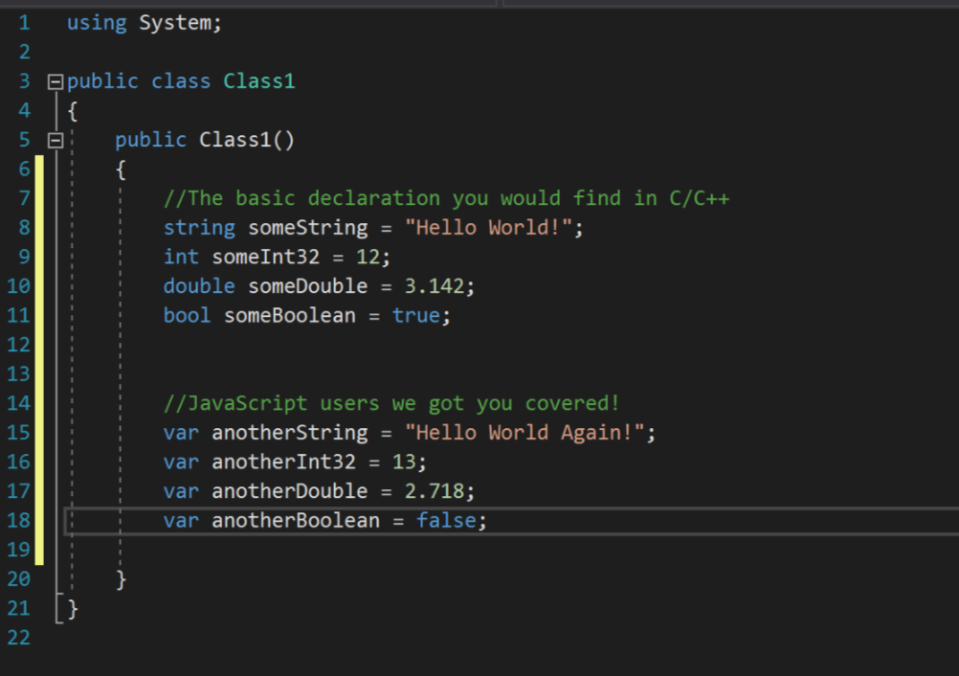
Object Declaration and Initialization

Slide 10
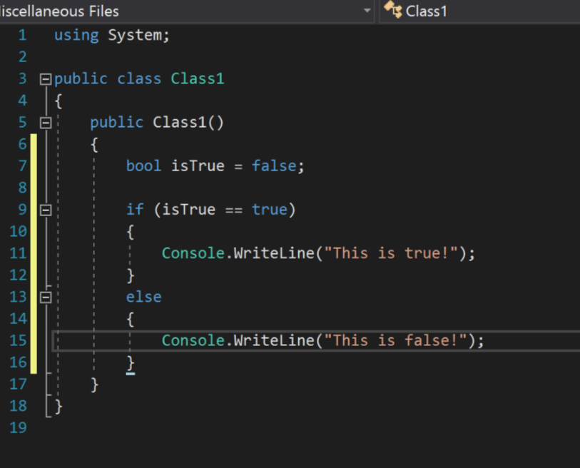
if… else…

Slide 11
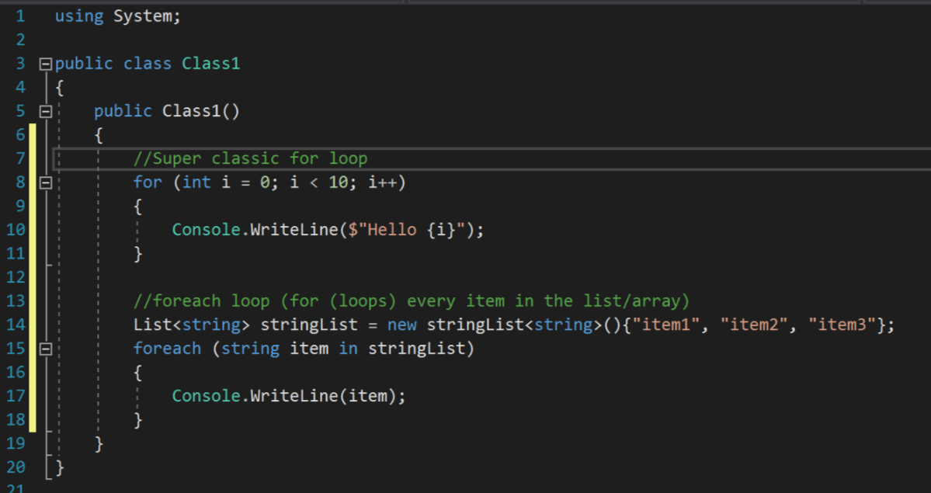
For loops

Slide 12
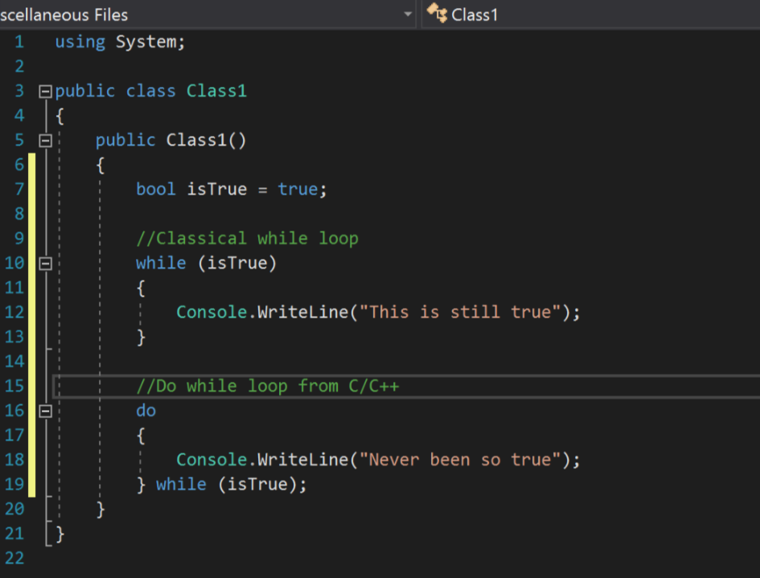
While loops

Slide 13
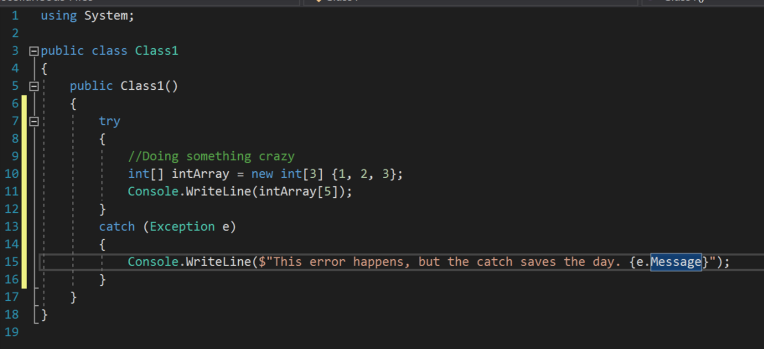
try… catch…

Slide 14
Quick Recap
If I get an input which represents exam marks for a certain paper (0-100), which is the simplest method to determine the grade? (i.e. above 70 is A, 60-70 is B, etc.)
if-else
try-catch
while
for loop

Slide 15
Some other useful things
List
Stores a bunch of object of the same type, something similar to array
Dictionary
Stores a bunch of object of the same type, along with an index for each object to identify it
Tuple
Stores a bunch of objects of different type
Notes:
Show usage example during this slide

Slide 16
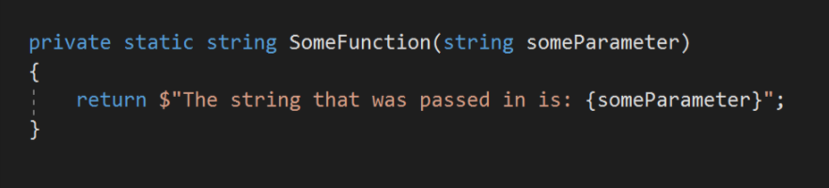













Functions
A function is a way of packaging code that does something and then returns the value.

Slide 17
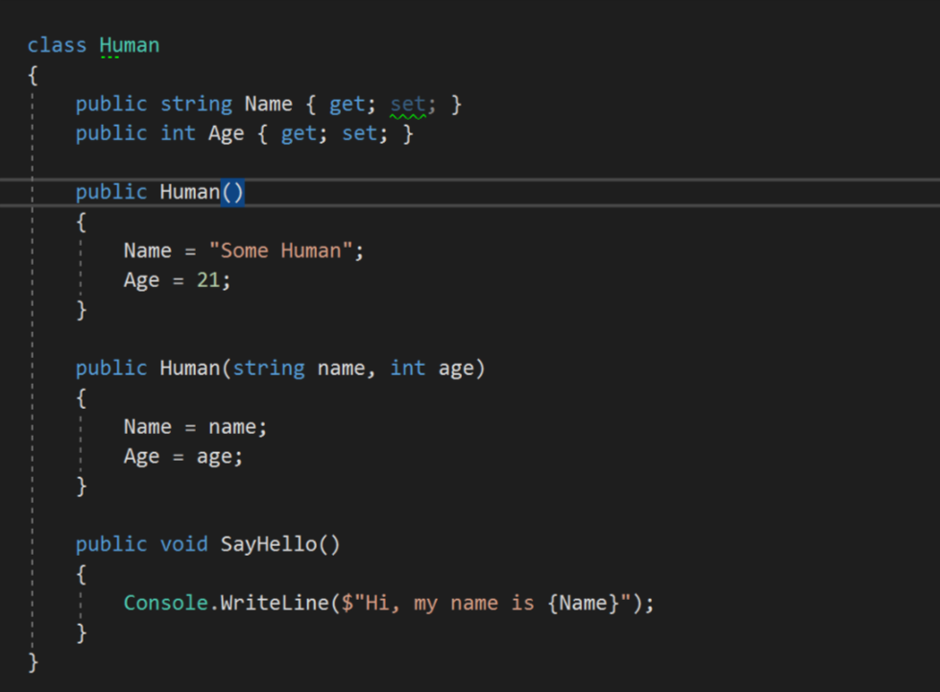



Class
Class can be imagined as an “object”, with properties describing the object, and the object does something (with functions)

Slide 18

Task
Create some classes with relevant properties and functions.
Try to utilize the class you created in the main function!

Slide 19
Some slide to show project screen
HOW TO SELECT THE RIGHT PrOjecT
wHAT TO DO IF I CANNOT FIND THE RIGHT PROJECt tO bE CreAtEd

Slide 20
NEXT WEEK…
How to construct User Interface (UI) using Extensible Application Markup Language (XAML)
Some basic layout types in XAML

Slide 21
Bonus
You can store a function as a variable
This variable type is known as delegate in C#
Properties in C# classes often have a private backing field if many operations have to be done in the getter and setters
Try creating a property with a private backing field
Properties are also able to have custom getters and setters
Try creating a property with a custom getter and setter which prints a line to console whenever either is called
C# object lifetime is managed, much like Java, using a garbage collector (GC). This is unlike C/C++ with manual memory management, or C++/python with reference counting

Slide 22
Bonus
C# has access modifier internal
This allows access within a library, while disallowing access outside of a library (i.e. a library user cannot call the function, but anything inside the library can call it)
If you understand polymorphism and inheritance, C# has both abstract base class and Interface
This is sometimes confusing as their roles are similar
However a class can only inherit 1 abstract base class, but can inherit multiple interfaces
It is advisable to take interfaces of objects as input parameter in classes and functions instead of the object type, as it makes testing easier by making a dummy object with the same interface and running the function
https://www.infoworld.com/article/2928719/application-development/when-to-use-an-abstract-class-vs-interface-in-c.html

